Slide 1
Papers
Divya Khanure (DXK210081)

Slide 2
ACM Transaction on Networking 2022
Multi-Associated Parameters Aggregation-Based Routing and Resources Allocation in Multi-Core Elastic Optical Networks
Goal - Reduce blocking probability and resource fragmentation, and thus increase resource utilization.
Challenges – Mutual restraint relationship, excessive consideration of certain factors causes deterioration of other factors.
Approach – Use of self-organizing feature mapping (SOFM) model to process multi-dimensional data with relevant features. Routing, core, and spectrum allocation are decided based on the core with higher transmission quality, and then the available slots are classified based on smaller crosstalk in a given direction.

Slide 3
Multi-Associated Parameters Aggregation-Based Routing and Resources Allocation in Multi-Core Elastic Optical Networks
Parameters for consideration -
Link length
Available bandwidth
Physical layer impairments
Complex crosstalk
Multi-dimensional fragmentation
Requirements for consideration –
Blocking probability
Link transmission quality/Quality of service (with priority)
Constraints for consideration –
Continuity
Contiguity
Non-overlapping
Crosstalk
Spectrum usage

Slide 4
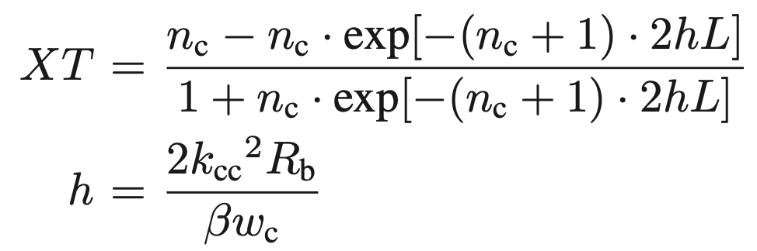
Multi-Associated Parameters Aggregation-Based Routing and Resources Allocation in Multi-Core Elastic Optical Networks
Physical Layer Impairments –
signal transmission direction will also interfere with the crosstalk evaluation model.
crosstalk models of co-directional transmission and non-directional transmission are slightly different.
Crosstalk Estimation Along Links:
n_{c} = no.of adjacent cores
L = transmission length
h = average increase in crosstalk per unit length
that depends on the coupling coefficient,
bend radius, propagation constant, and core-pitch

Slide 5
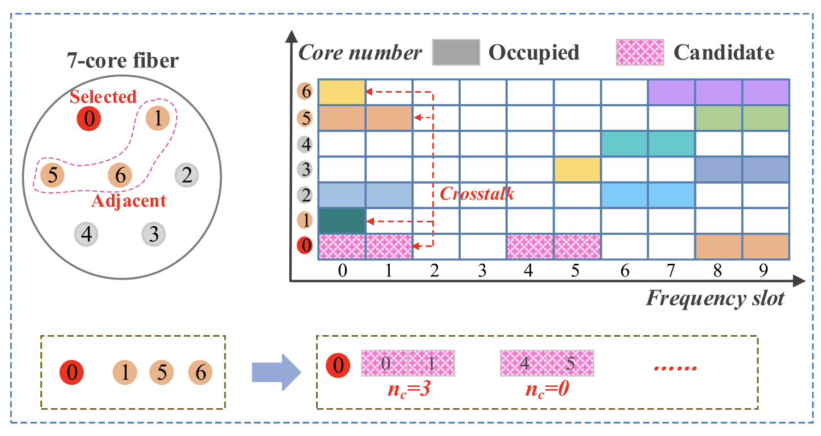
Multi-Associated Parameters Aggregation-Based Routing and Resources Allocation in Multi-Core Elastic Optical Networks
Physical Layer Impairments –
Crosstalk Estimation Along Links:
Compute crosstalk for the same direction and opposite direction.
Compute wavelength.

Slide 6
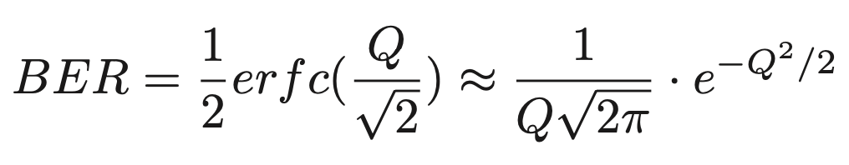
Multi-Associated Parameters Aggregation-Based Routing and Resources Allocation in Multi-Core Elastic Optical Networks
Physical Layer Impairments –
Physical Impairments Consideration
The amplified spontaneous emission (ASE), cross-phase modulation (XPM), and four-wave mixing (FWM) are used for the computation of linear and non-linear impairments.
Q-factor is used for the Quality of transmission estimation for BER given by
For OOK channels, the Q-factor is related with the receiver sensitivity and the signal-to noise ratio (SNR) per symbol.
for QPSK channels, the Q-factor estimation will be complex, and it is also closely related to the self-phase modulation (SPM) and XPM.

Slide 7
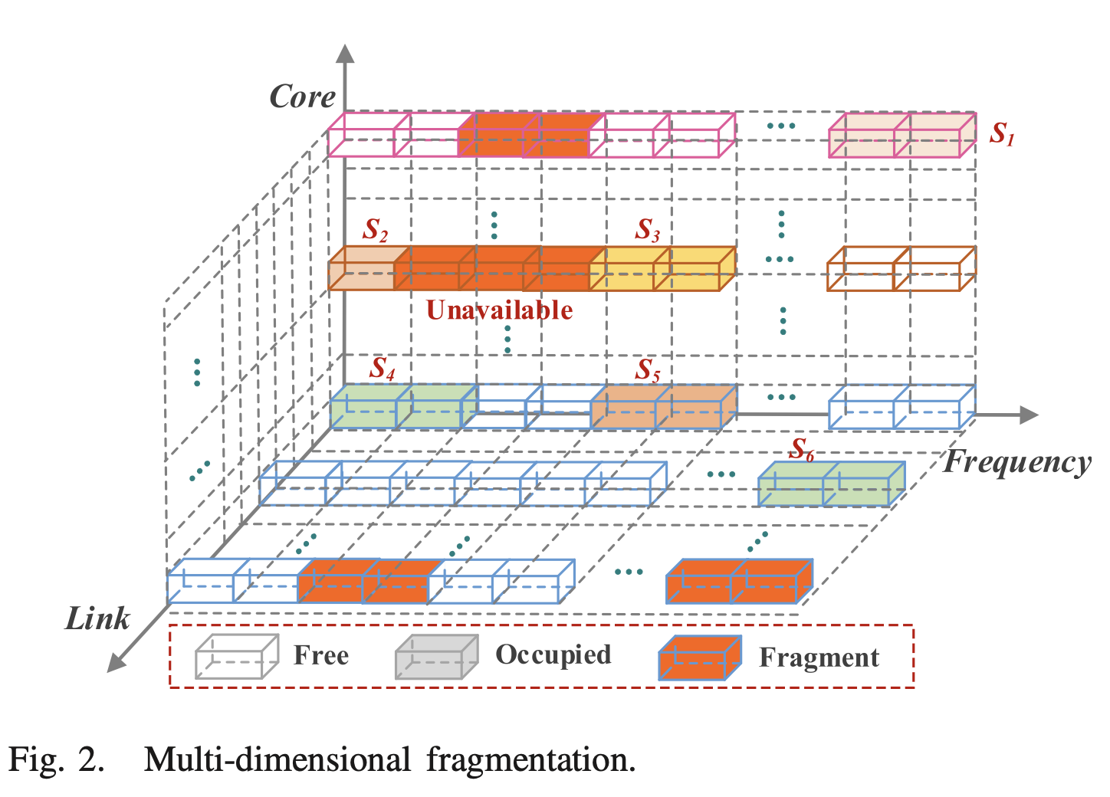
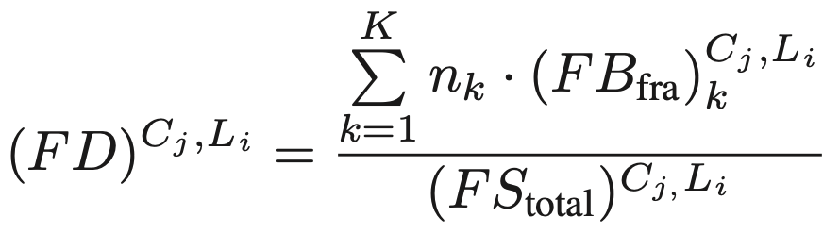
Multi-Associated Parameters Aggregation-Based Routing and Resources Allocation in Multi-Core Elastic Optical Networks
Multi-Dimensional Resource Fragmentation
Three dimensions that are considered are link, core, and frequency.
For a core on a certain link, if at the moment, some continuous spectrum blocks are unavailable it’s treated as multi-dimensional fragments and is computed as fragmentation degree given as:
where FB_{fra} = fragmented frequency block
FS_{total} = total number of Frequency Slot

Slide 8
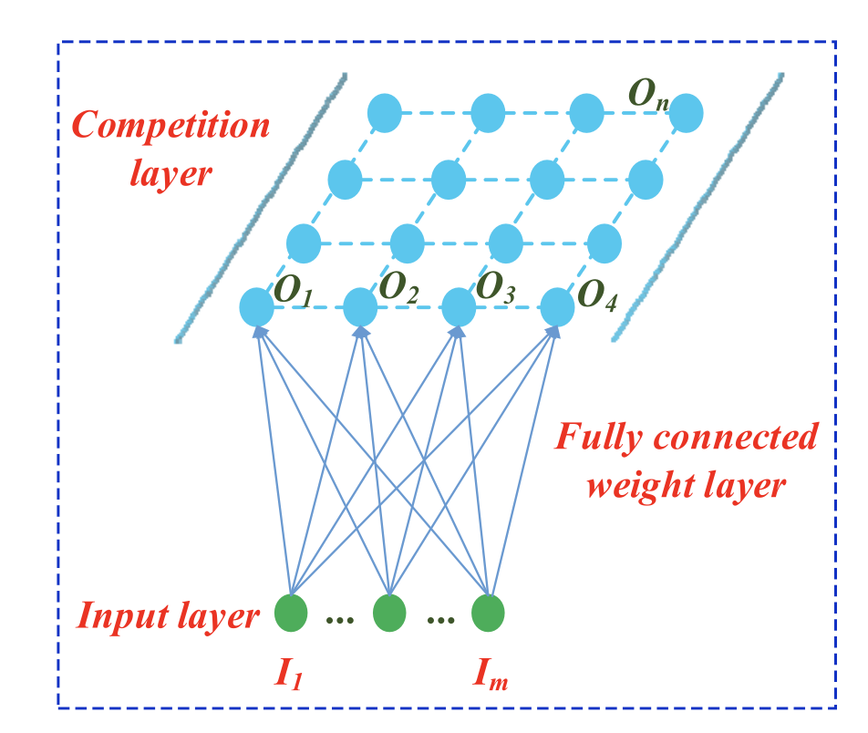
Multi-Associated Parameters Aggregation-Based Routing and Resources Allocation in Multi-Core Elastic Optical Networks
Routing and spectrum assignment algorithm based on SOFM:
Typical SOFM Model - The SOFM network has two layers and each neuron in the input layer collects external information from each neuron in the output layer through a fully connected weight layer.
the winning neuron in the output layer and its surro-
unding neurons need to adjust the weight vector.
Training - First, initialize parameters including weight
vector, learning rate, an initial winning neighborhood
Then, input samples to find the winning neuron and
update the weight vector. If the learning rate is zero,
the training ends.
In MC-EONs, each factor collected from the core level
can be used as a dimension to be input into SOFM
model, and finally, the reordered cores along each
link will be output.

Slide 9
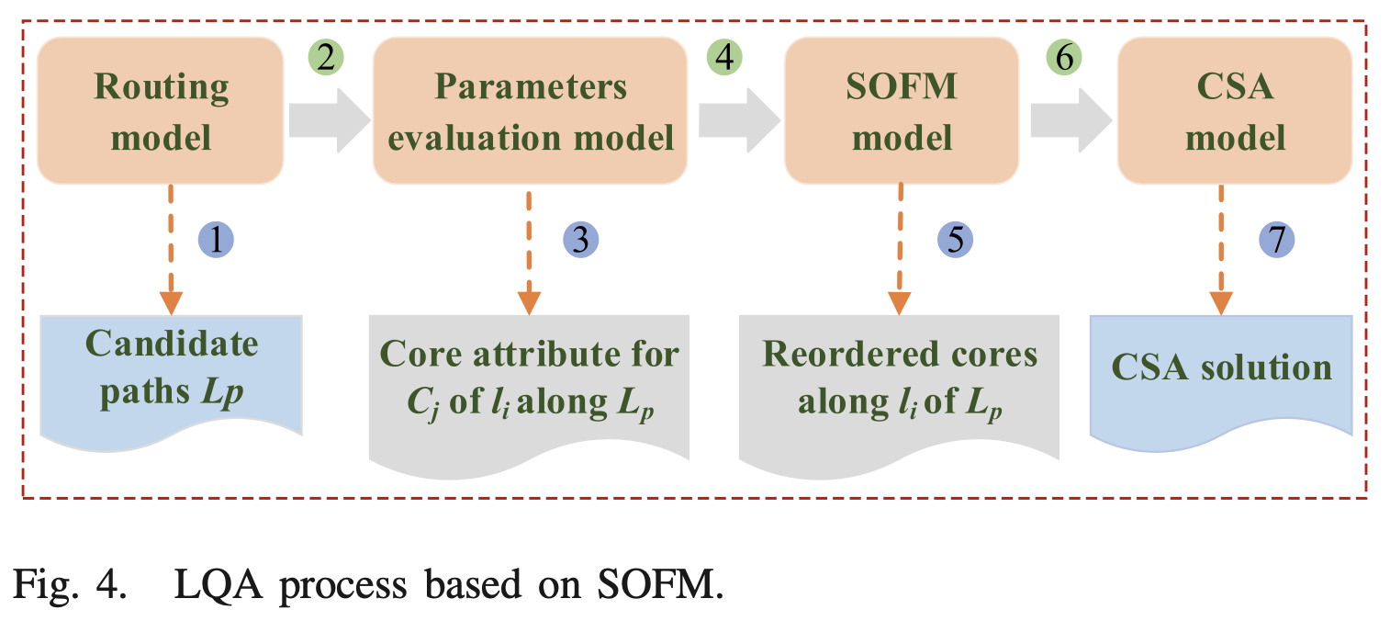
Multi-Associated Parameters Aggregation-Based Routing and Resources Allocation in Multi-Core Elastic Optical Networks
Routing and spectrum assignment algorithm based on SOFM:
Link Quality Assessment Based on SOFM From Core Level –
Routing model will output k shortest paths for the new service.
Evaluate the impact of multiple parameters in each core Cj along each link li of each path Lp to form a core attribute set.
input this set into the SOFM model to obtain the reordered core set along li of Lp.
This output set will be used as a reference for resource allocation to obtain a CSA solution for each service.

Slide 10
Multi-Associated Parameters Aggregation-Based Routing and Resources Allocation in Multi-Core Elastic Optical Networks
Routing and spectrum assignment algorithm based on SOFM:
Link Quality Assessment Based on SOFM From Core Level –
For a TA-MCF network –
7 cores are deployed
Input - The service S has service index, the source node, destination node, crosstalk threshold which is determined by the selected modulation format, and number of slots consistent with the service bandwidth requirement.
Output - The Link L has link length, selected core, number of services carried in selected core, available bandwidth, resource utilization, crosstalk and BER evaluation, and fragmentation degree.

Slide 11
Multi-Associated Parameters Aggregation-Based Routing and Resources Allocation in Multi-Core Elastic Optical Networks
Routing and spectrum assignment algorithm based on SOFM:
RCSA Based on LQA-SOFM –
Step 1: Routing process - When new services arrive at the network, calculate k shortest paths for Service S.
Step 2: Core selection process - Multi-parameter evaluation is performed for each core C_{j} on each link L_{i} of each candidate path. The reordered output of SOFM of the core level for each link is taken.
Step 3: Spectrum assignment process – For each link, l_{i} of each candidate path, the free slot blocks in C_{j} are classified in ascending order of the number of adjacent cores labeled as n_{c}. The slot block with the smallest n_{c} will be preferred.
Step 4: Reclassify the free slot blocks in the selected class with smaller n_{c} by the number of adjacent cores with the same and opposite directions indicated as n₁ and n₂
Select a spectrum and calculate the actual crosstalk and Q values for the new service S. If they meet the requirement, the new service will be served successfully.

Slide 12
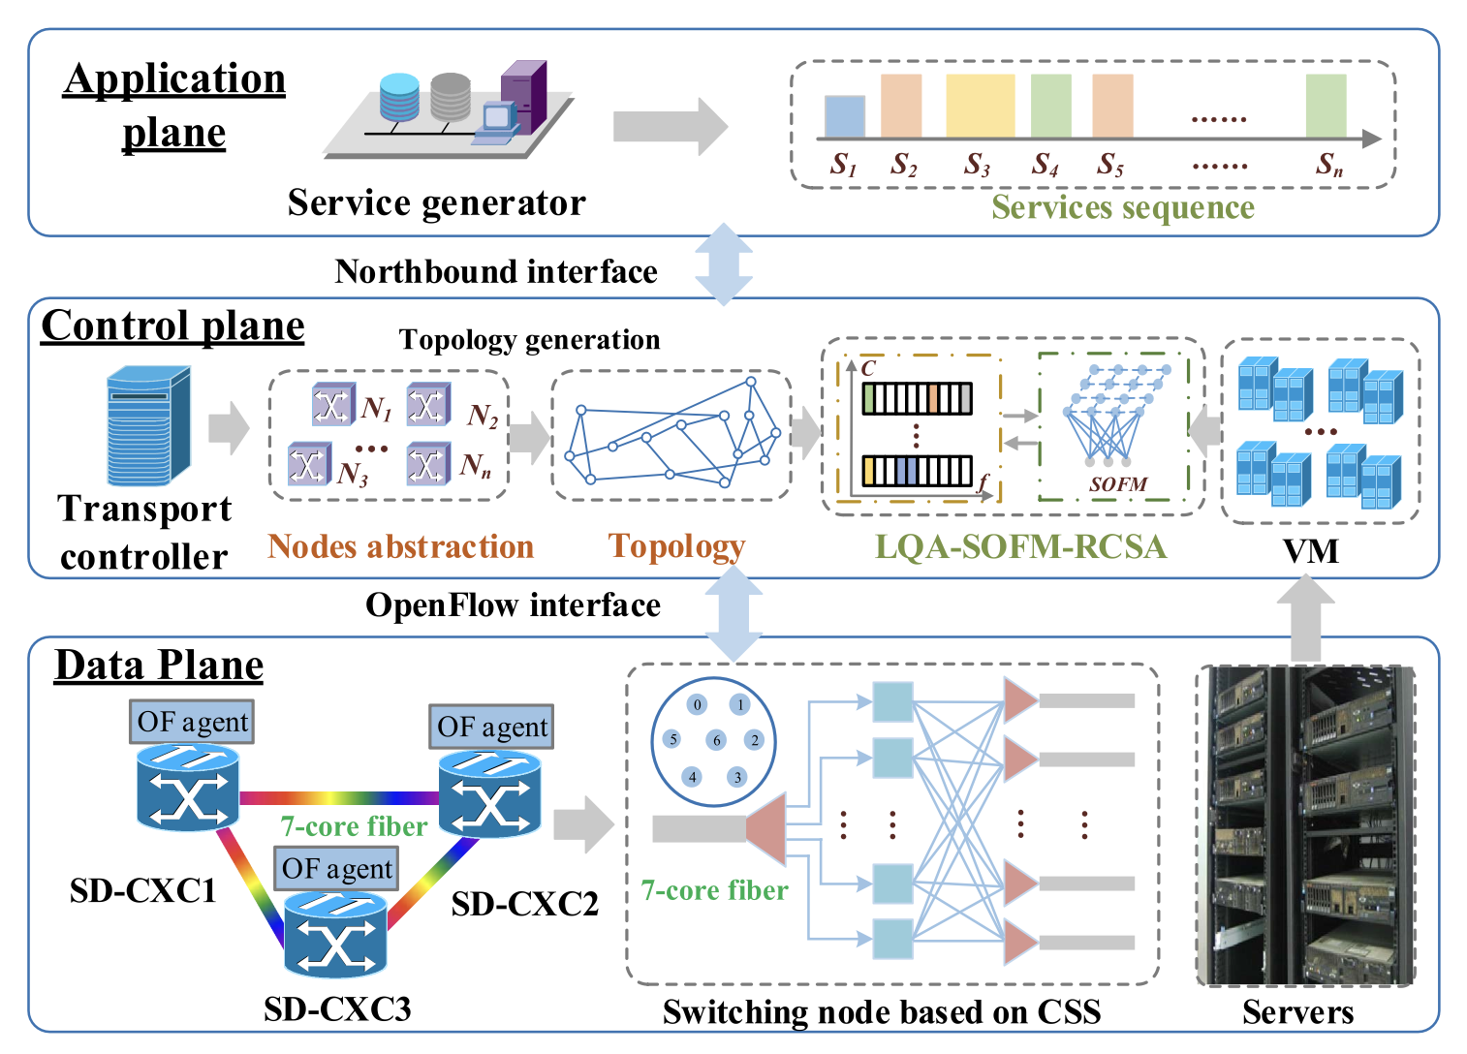
Multi-Associated Parameters Aggregation-Based Routing and Resources Allocation in Multi-Core Elastic Optical Networks
Experimental setup
Data plane - software-defined core cross-connect (SD-CXC) node model based on the core selective switch developed with OpenFlow agent.
All nodes are implemented by virtual machines.
All links are virtualized and equipped with 7-core fibers with available 358 slots for each core.
Control plane - transport controller is developed by the Boron version of OpenDaylight.
Application plane - service generator dynamically generates service sequences with different bandwidth granularities including 10 or 40 Gb/s

Slide 13
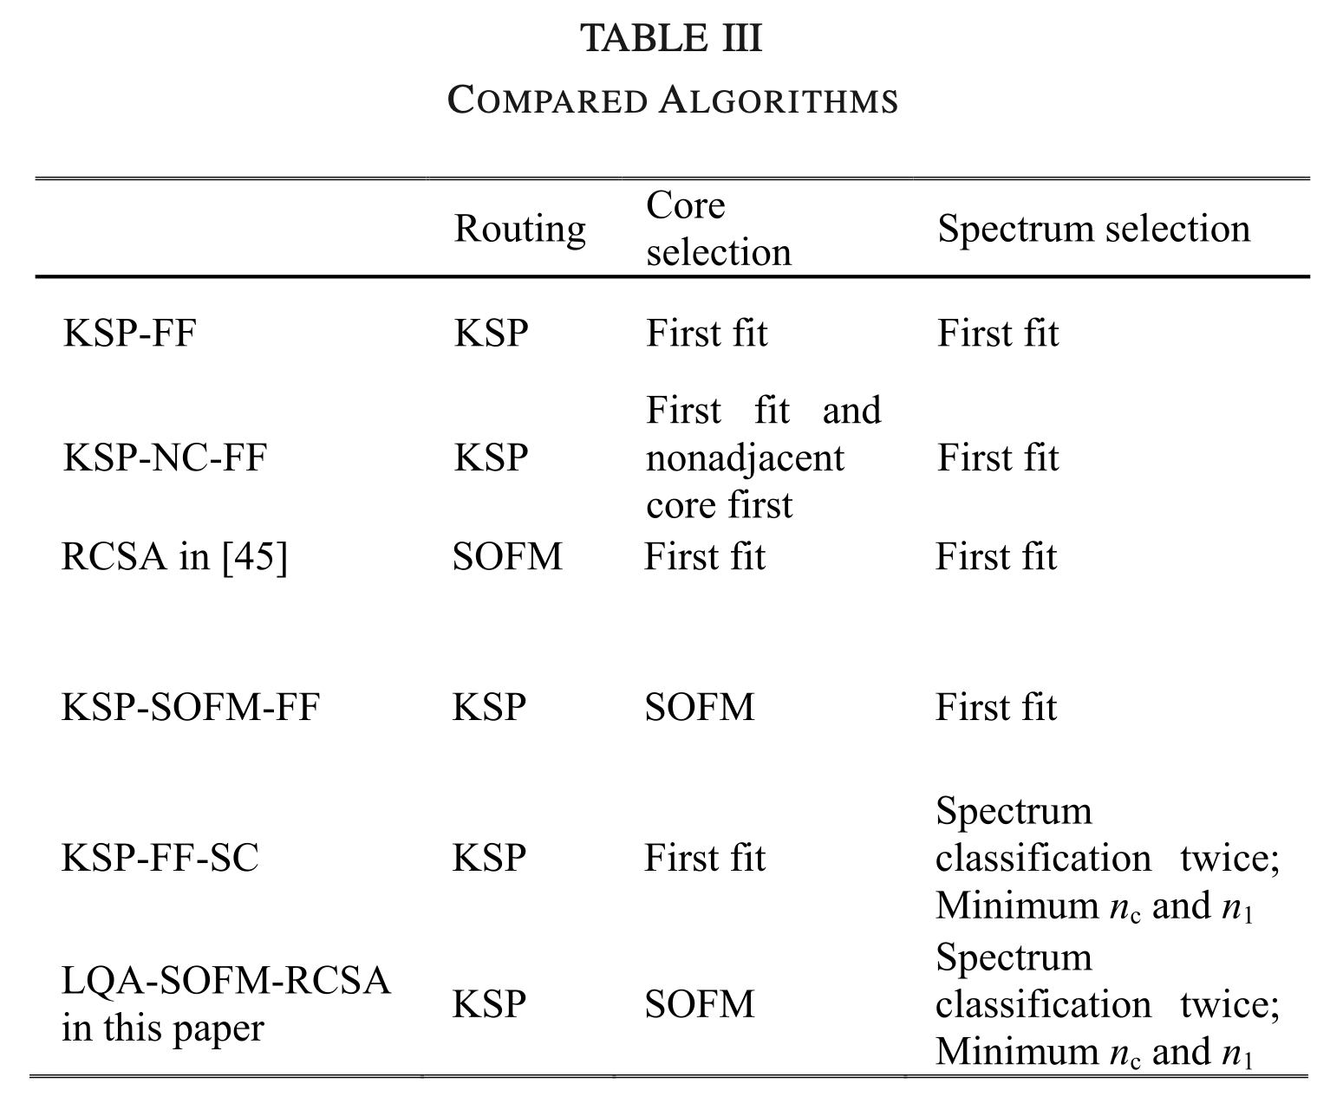
Multi-Associated Parameters Aggregation-Based Routing and Resources Allocation in Multi-Core Elastic Optical Networks
Compared algorithms
KSP: k shortest path
KSP-FF: KSP first fit
KSP-FF-SC: KSP-FF-spectrum classification
KSP-NC-FF: KSP-Nonadjacent core-FF
KSP-SOFM-FF: KSP-Self organizing feature
mapping – FF
LQA-SOFM-RCSA: Link quality assessment
- SOFM - RCSA

Slide 14
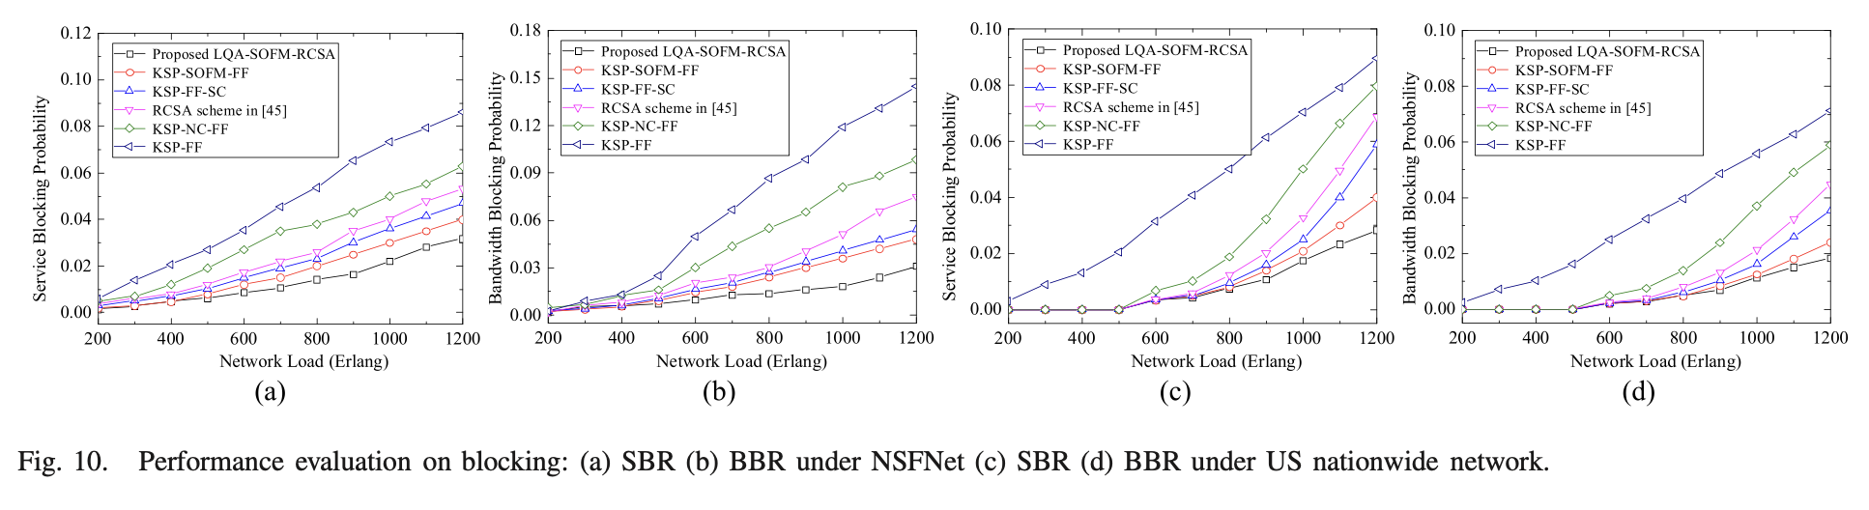
Multi-Associated Parameters Aggregation-Based Routing and Resources Allocation in Multi-Core Elastic Optical Networks
Performance Evaluation
Blocking Probability: in terms of SBR and BBR

Slide 15
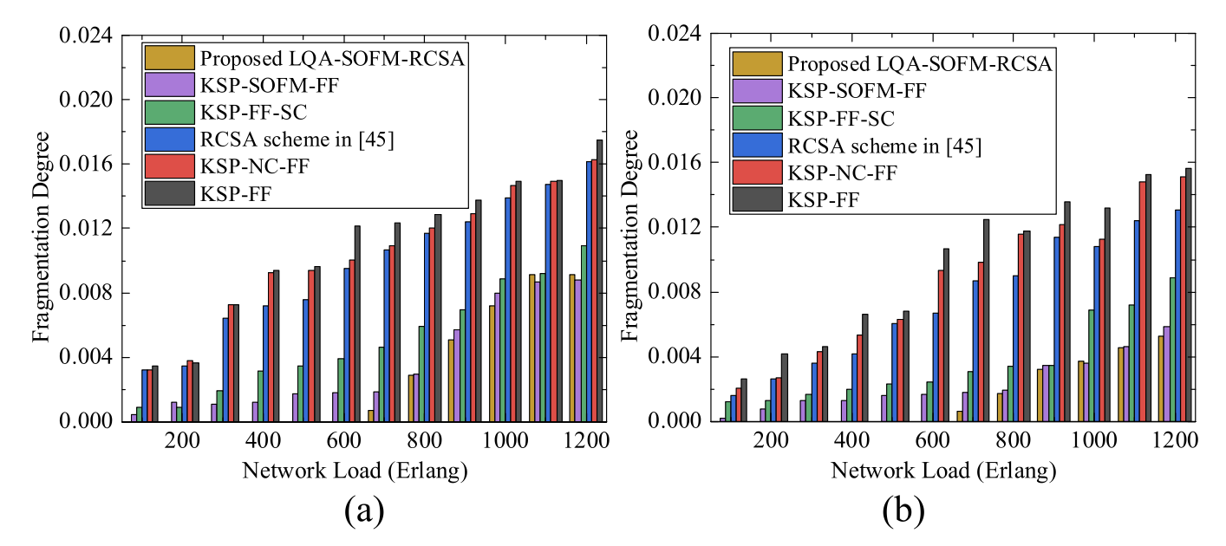
Multi-Associated Parameters Aggregation-Based Routing and Resources Allocation in Multi-Core Elastic Optical Networks
Performance Evaluation
2. Fragmentation Degree:

Slide 16
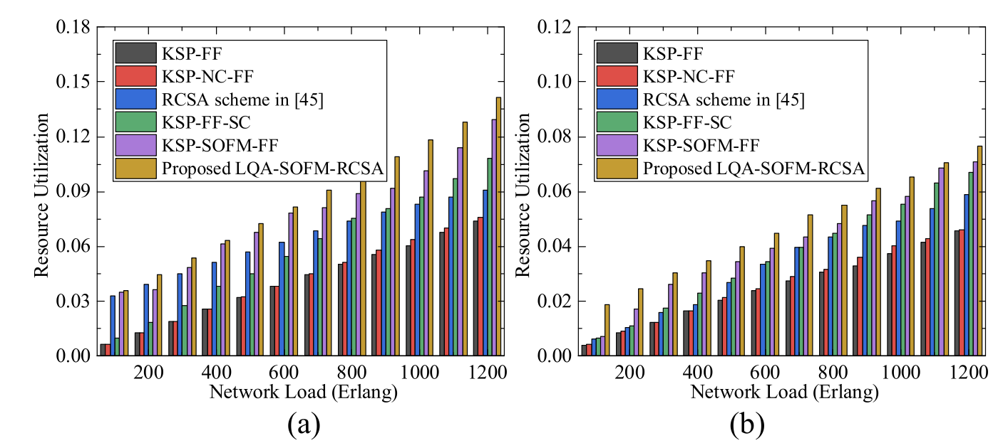
Multi-Associated Parameters Aggregation-Based Routing and Resources Allocation in Multi-Core Elastic Optical Networks
Performance Evaluation
3. Resource Utilization:

Slide 17
Multi-Associated Parameters Aggregation-Based Routing and Resources Allocation in Multi-Core Elastic Optical Networks
Performance Evaluation
RCSA scheme in [45] only starts from the path dimension and selects the path with better transmission quality.
KSP- SOFM-FF only selects cores with better transmission quality in the core dimension but still exploits the FF method in the spectrum dimension.
KSP-FF-SC uses secondary classification in the spectrum dimension, the FF method is still used for core selection.
The proposed algorithm considers all the features making it a 3-dimensional approach, against the above-mentioned algorithms that are 1-dimensional as they consider only a single feature.

